Slide 1

The Future of 5G and Its Impact on IoT Networks

Slide 2

INTRODUCTION
The fifth generation of wireless communication, 5G, is more than just faster internet. It is designed to support massive data exchanges, ultra-low latency, and higher device density. These features make 5G a transformative force for Internet of Things (IoT) applications, from smart cities to industrial automation.

Slide 3
TABLE OF CONTENTS
01
A New Era of Connectivity
03
Real-World Applications of 5G and IoT
02
Key Features of 5G Empowering IoT
04
Challenges and Future Outlook of 5G-Enabled IoT

Slide 4

01
A New Era of Connectivity
5G is the fifth generation of wireless technology, offering faster speeds, lower latency, and the ability to connect many devices at once. The Internet of Things (IoT) is a network of physical devices that collect and share data over the internet. Together, 5G and IoT enable smarter, faster, and more responsive systems across homes, cities, and industries. This powerful combination marks a major step toward a more connected and intelligent world.

Slide 5
02
Key Features of 5G Empowering IoT
5G introduces several advanced features that greatly enhance IoT performance, including ultra-fast data speeds and ultra-low latency. It supports massive device connectivity, allowing up to a million devices per square kilometer to operate simultaneously. Network slicing in 5G enables the creation of customized virtual networks for different IoT applications. These features make 5G the ideal backbone for supporting complex, large-scale IoT environments like smart cities and industrial automation.

Slide 6
03
Real-World Applications of 5G and IoT
The combination of 5G and IoT is transforming industries through real-world applications. In smart cities, it enables intelligent traffic systems, energy management, and public safety monitoring. Healthcare benefits from remote patient monitoring and real-time data sharing through wearable devices. Other areas like autonomous vehicles, industrial automation, and smart farming are also advancing rapidly with the support of 5G-powered IoT solutions.

Slide 7
04
Challenges and Future Outlook of 5G-Enabled IoT
Despite its potential, the integration of 5G with IoT faces challenges such as high infrastructure costs, security concerns, and device compatibility issues. Ensuring data privacy and managing the massive number of connected devices require robust security solutions. However, the future of 5G-enabled IoT is promising, with ongoing investments in smart infrastructure and private 5G networks. As technology evolves, 5G will continue to drive innovation and transform how we live, work, and interact with the world.

Slide 8

Conclusion
5G is a game-changer for the IoT ecosystem. Its ability to handle high-speed, low-latency, and high-density connections unlocks new possibilities across industries. Despite challenges, the convergence of 5G and IoT is expected to revolutionize how devices interact and how data is used to make intelligent decisions.

Slide 9

My Thoughts on the 5G Network
I believe 5G is a major step forward in technology that will change how we connect and communicate. Its high speed and low latency can improve daily life, from faster mobile internet to smarter homes and cities. However, I also think it's important to address challenges like data privacy, security, and equal access to make sure everyone benefits from this progress.

Slide 10
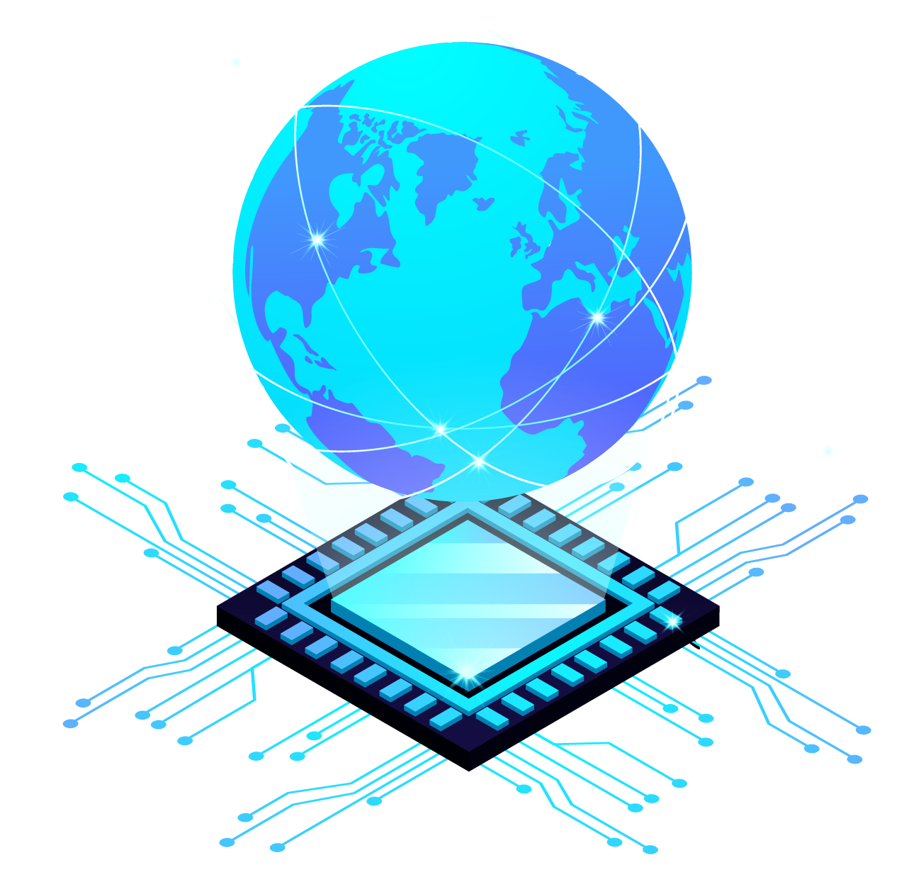
Thanks for Attention

